Slide 1
IDENTIFYING DOG BREEDS BASED ON VISUAL VARIATIONS IN APPEARANCE, USING CONVOLUTION NEURAL NETWORKS & TRANSFER LEARNING
GROUP-1

Slide 2
01
TABLE OF CONTENTS
02
03
04
PROBLEM STATEMENT
DATA
METHODOLOGY
RESULT

Slide 3
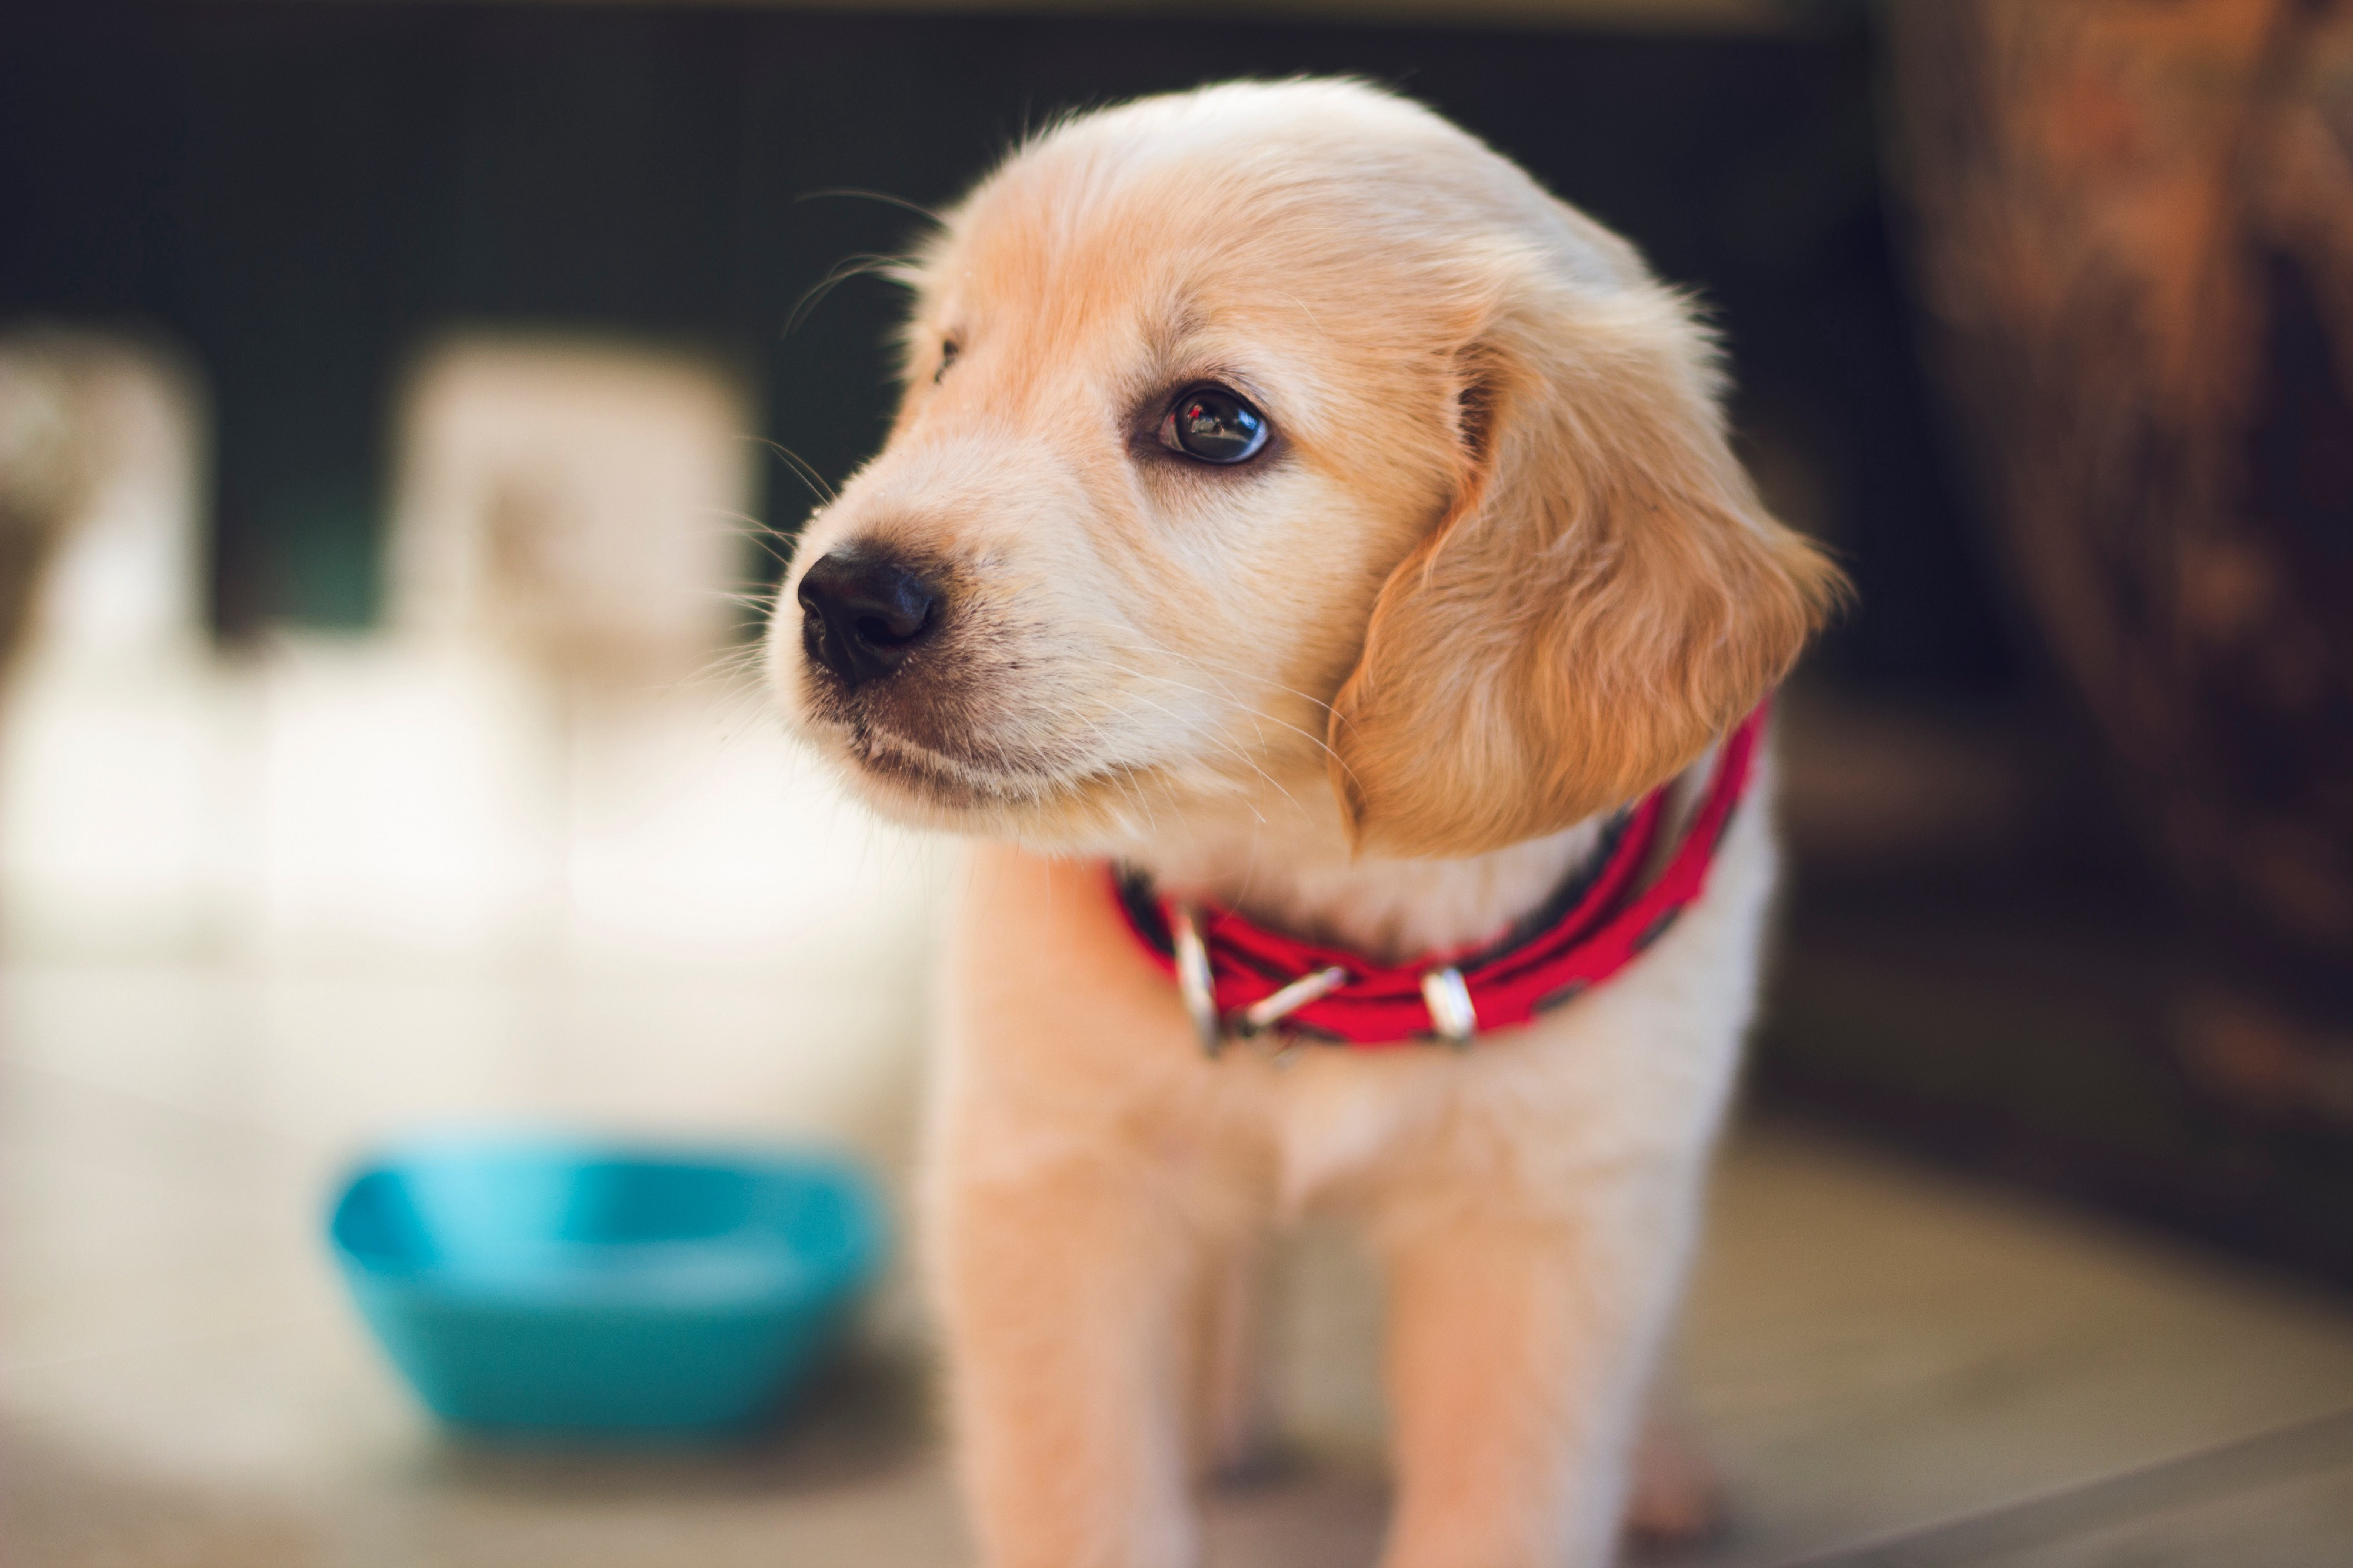
PROBLEM STATEMENT
The main objective of this capstone project is to be able to identify the breed a dog belongs to based on the visual differences in appearance observed between different dog breeds. To add to this, the large number of different possible dog breeds only complicates this challenge.
The task is to leverage computer vision capabilities to successfully identify the breed of a dog, from around 120 breeds, based on the subtle visual differences.
What’s my breed?

Slide 4
Applications of dog breed identification
Public health journals
Treatment of stray dogs
Veterinary medical records
Lost and Found notices
Dog license documents
Animal shelter descriptions

Slide 5
DATA (1/2)
The images used for this project were part of the Stanford Dogs Dataset, prepared by Aditya Khosla, Nityananda Jayadevaprakash, Bangpeng Yao and Li Fei-Fei. The dataset comprises of 20580 images of dogs, across 120 breeds, split between training & testing datasets.
The actual data was hosted by Kaggle as part of it’s Playground Prediction Competition hosted in 2017, and is divided in the below format:
train.zip - the training set, comprised of images of different dog, belonging to one of 120 breeds. Each image had a file name that is its unique id.
test.zip – the testing set, where the model is expected to predict the probability of the image belonging to one of the 120 breeds
sample_submission.csv - a sample submission file in the correct format
labels.csv - mapped the breeds, for the images in the train set, with the corresponding image id.

Slide 6
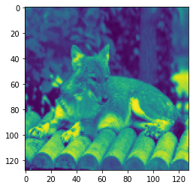
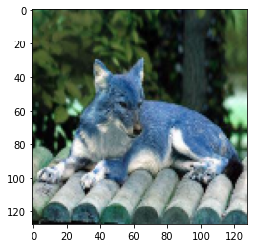
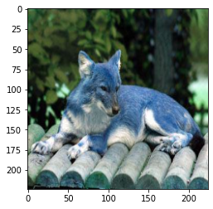
DATA (2/2)
For our capstone, we used only the train.zip file, as the images in test.zip were not annotated.
There were around 10222 images in the train.zip file, spread across 120 different classes (or breeds).
The labels.csv was used to tag each of these 10222 images to a particular class/dog breed
We split these 10222 images into training & validation sets in the ratio of 80:20 or 90:10, taking mostly 10k images due to memory constraint.
These images were further extracted either in grayscale, or colour. For the former, the images were in size 128X128, while for the latter it was either 128X128 or 224X224.
Sample Images from the dataset, showing the 3 versions of image extracted: grayscale with 128X128, color (bgr) with 128X128 & color (bgr) with 224X224

Slide 7
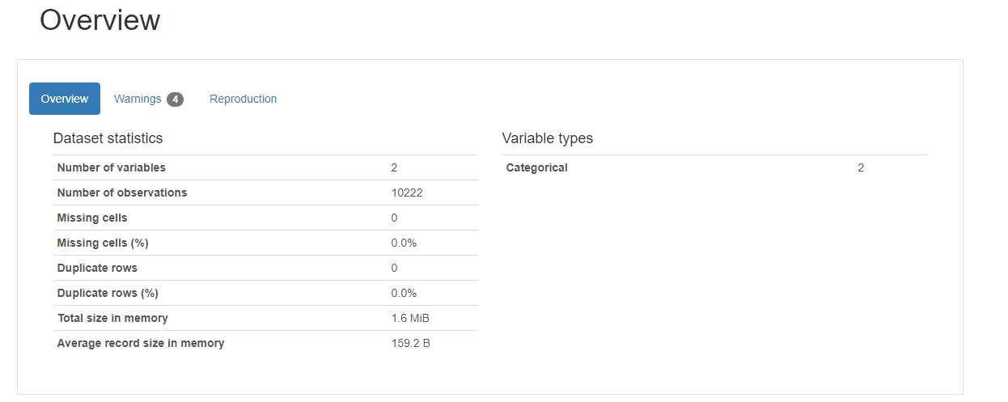
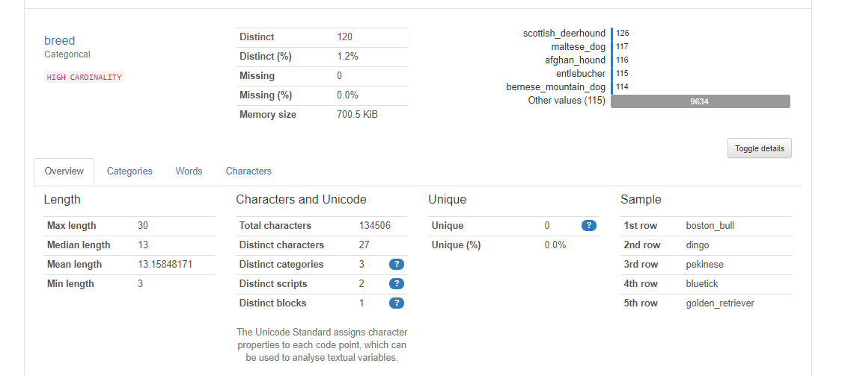
Using Pandas Profiling for Preliminary EDA
120 Distinct Breeds

Slide 8
METHODOLOGY (1/3)
Evaluated multiple models, both drawn from scratch, as well as using Transfer Learning.
Used models with & without Image Augmentation.
Models:
Custom models trained on 128X128 grayscale images with & without Image Augmentation
VGG-16 models with & without pre-trained weights, trained on 128X128 colour (BGR) images with & without Image Augmentation
Pre-trained Resnet50 models, trained on 224X224 colour (BGR) images with & without Image Augmentation. Model was also trained keeping the hidden layers as trainable.
Pre-trained MobileNet models, trained on 224X224 colour (BGR) images with & without Image Augmentation.
Pre-trained MobileNet models, trained on 224X224 colour (BGR) images with & without Image Augmentation, on a larger training set of 9k images & 1k validation images.
Used ROC-AUC & Top-5 Accuracy as the evaluation metrices.

Slide 9
METHODOLOGY (2/3)
Approach
Pre-processing
Resize image
Image Augmentation
Model Selection
Custom CNN
Accuracy Calculation
Train accuracy
Test accuracy
VGG-16
Resnet-50
Mobilenet V2
ROC-AUC score

Slide 10
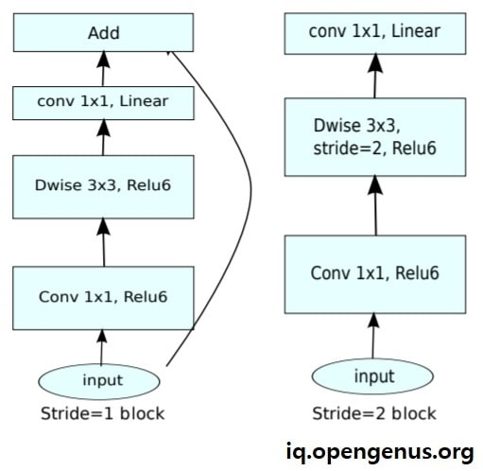
METHODOLOGY (3/3)
The best performing model for dog breed classification was the Mobilenet V2 model
Mobilenet V2 is based on an inverted residual structure where the residual connections are between the bottleneck layers. The intermediate expansion layer uses lightweight depth wise convolutions to filter features as a source of non-linearity. As a whole, the architecture of MobileNetV2 contains the initial fully convolution layer with 32 filters, followed by 19 residual bottleneck layers

Slide 11
RESULT
Model | Model Name | Image Augmentation (Y/N) | Training Accuracy | Validation Accuracy | Val Top 5 Accuracy | ROC-AUC Score
1 | Custom CNN Architecture | N | 1.23% | 1.08% | 5.23% | 0.50
2 | Custom CNN Architecture | Y | 1.24% | 0.99% | 4.86% | 0.49
3 | VGG-16 with pre-trained weights | N | 99.96% | 29.34% | 60.54% | 0.92
4 | VGG-16 with pre-trained weights | N | 54.76% | 25.23% | 53.89% | 0.92
5 | VGG-16 with pre-trained weights | Y | 21.35% | 19.39% | 47.72% | 0.89
6 | Resnet-50 using pre-trained weights | N | 1.15% | 0.75% | 5.05% | 0.5
7 | Resnet-50 using pre-trained weights | Y | 1.09% | 0.76% | 5.04% | 0.5
8 | Resnet-50 with all layers trainable | N | 5.92% | 4.80% | 18.75% | 0.77
9 | Mobilenet V2 with pre-trained weights | N | 99.96% | 71.40% | 93.65% | 0.99
10 | Mobilenet V2 with pre-trained weights | Y | 74.9% | 65.78% | 91.53% | 0.99
11 | Mobilenet V2 with pre-trained weights on 90:10 split | N | 98.9% | 67.10% | 91.2% | 0.99
12 | Mobilenet V2 with pre-trained weights on 90:10 split | Y | 71.62% | 65.12% | 91.94% | 0.99

Slide 12
THANKS

